Slide 1
Sprint 1
By Kevin Herrera, Brian Leung, Ishaan Joshi

Slide 2
Introduction
Project: A Claim Complexity Algorithm for Penser North America, a workers compensation third party administrator in Washington. It scores the complexity of each claim and gives a separate cost estimate. It has machine learning models, a web interface, and an API, and is meant to support decisions. Sprint 1 focused on gathering requirements and planning while we wait on the sanitized claims data.
Team:
Kevin is team lead, with full stack development and AI experience.
Brian has experience in ML and Data Science.
Ishaan has experience in Algorithms and Formal Methods.

Slide 3
2. Sprint Objectives
Sprint 1 ran from September 4 to October 11 and was a planning and research sprint which is what Penser proposed for the first sprint. Our goals were to gather requirements through meetings with Penser, sign the confidentiality agreements needed for data access, and turn the requirements into user stories, use case diagrams, and UML diagrams. We researched different approaches and worked on the skills we need for the project.

Slide 4
3. Requirements Gathering
Meeting 1 - Kick-off Meeting (30 mins)
Meeting 2 - Requirements Meeting (30 mins)
Meeting 3 - Check-in Meeting (30 mins)
Summarized notes:
Three client meetings were held. The client will provide about 10k records over 5 years, around 7 MB of diary notes sanitized by Penser. They expect retraining roughly every 6 months. We are given a $300–500 training budget. Including $100–300 in AWS credits. AWS Cognito for authentication. The system is expected to handle a performance target of 1–3 claims per minute on average, up to 10 per minute.

Slide 5
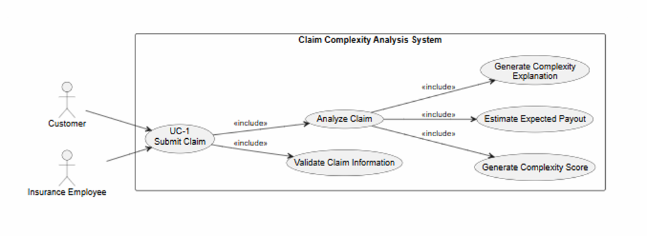
4. User Stories, Use Cases, UML
Figure 1. UC-1 UML diagram
UC-1: Submit Claim
Actor: Customer or Insurance Employee
An authenticated user submits claim information through the web interface. The system validates the information and submits it for analysis. The analysis produces a complexity score, expected payout, and explanation of the complexity score.

Slide 6
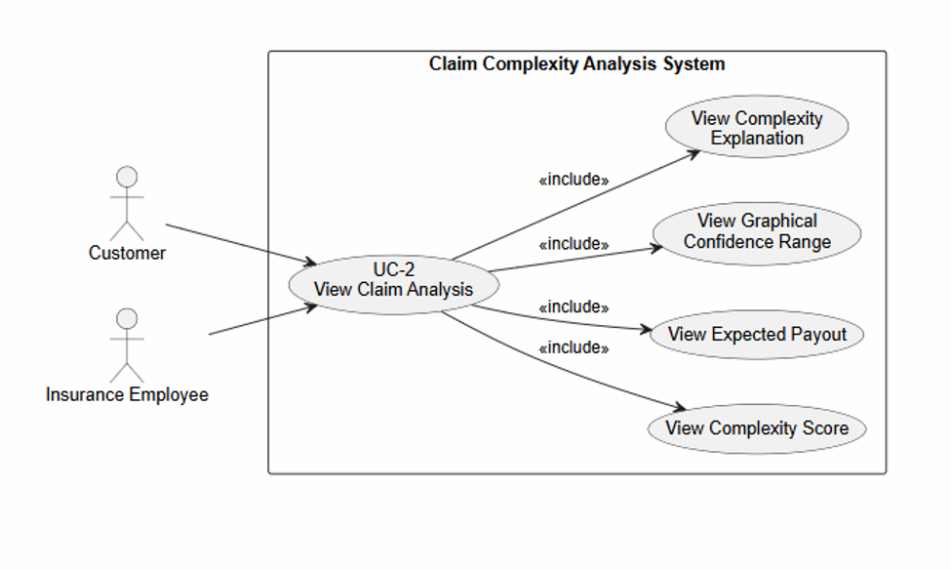
4. User Stories, Use Cases, UML
Figure 2. UC-2 UML diagram
UC-2: View Claim Analysis
Actor: Customer or Insurance Employee
The user views the complexity score, expected payout, graphical confidence range, and an explanation of the factors contributing to the complexity score.

Slide 7
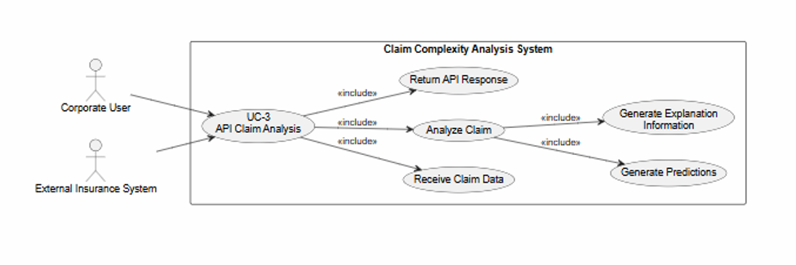
4. User Stories, Use Cases, UML
Figure 3. UC-3 UML diagram
UC-3: API Claim Analysis
Actor: Corporate User / External System
An external insurance system submits claim information through the API and receives the model's predictions and applicable explanation information.

Slide 8
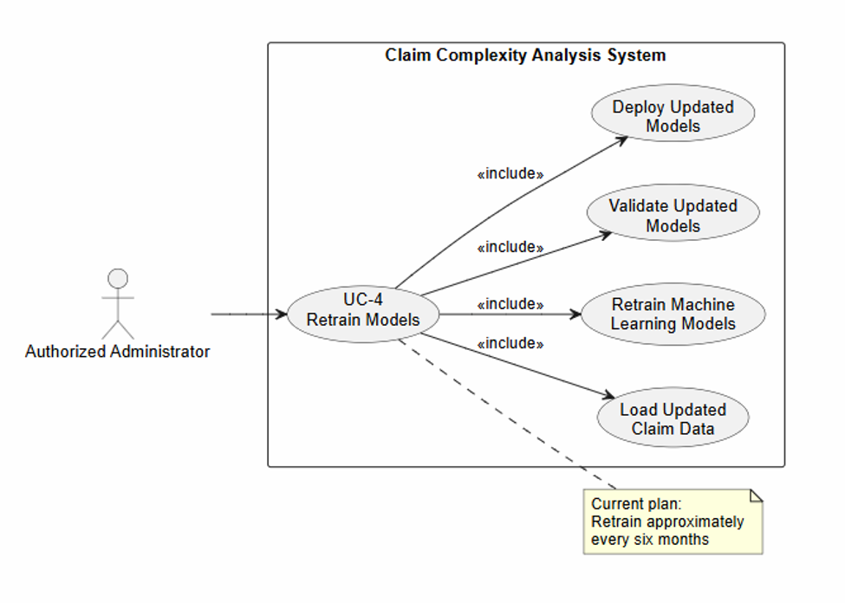
4. User Stories, Use Cases, UML
Figure 4. UC-4 UML diagram
UC-4: Retrain Models
Actor: Authorized Administrator
The system's machine learning models are retrained using updated claim data. The current plan is to retrain approximately every six months.

Slide 9
4. User Stories, Use Cases, UML
US-1 — Customer Submits a Claim
User Story:
As a customer, I want to submit my claim information, so that the system can analyze my claim.
Success Conditions:
Given I am an authenticated customer with valid claim information,
When I submit my claim,
Then the system accepts the claim and generates a complexity score, expected payout, confidence range, and explanation of the complexity score.
Exceptional Conditions:
Given my claim information is incomplete or invalid,
When I submit the claim,
Then the system informs me that the claim cannot be processed and identifies the required information.

Slide 10
4. User Stories, Use Cases, UML
US-2 — Customer Views Claim Analysis
User Story:
As a customer, I want to view my claim analysis, so that I can understand the expected complexity and cost of my claim.
Success Conditions:
Given my claim has been successfully analyzed,
When I view the claim results,
Then the system displays the complexity score, contributing factors, expected payout, graphical confidence range, and explanation of the complexity score.
Exceptional Conditions:
Given an analysis is unavailable or cannot be completed,
When I attempt to view the results,
Then the system informs me that the analysis is unavailable.

Slide 11
4. User Stories, Use Cases, UML
US-3 — Claims Handler Analyzes a Claim
User Story:
As a claims handler, I want to analyze a claim, so that I can better understand its complexity and expected cost.
Success Conditions:
Given I am an authenticated claims handler with valid claim information,
When I submit the claim for analysis,
Then the system provides the complexity score, contributing sub-scores, expected payout, confidence range, and explanation of the complexity score.
Exceptional Conditions:
Given the claim information is incomplete or invalid,
When I submit the claim,
Then the system identifies the invalid or missing information and does not generate an analysis.

Slide 12
4. User Stories, Use Cases, UML
US-4 — Corporate User Integrates the System
User Story:
As an insurance company, I want to access the claim analysis system through an API, so that I can integrate claim analysis into existing software.
Success Conditions:
Given the external system provides valid claim information through the API,
When the API receives the request,
Then the system processes the claim and returns the applicable analysis results, including the complexity score, expected payout, and explanation information.
Exceptional Conditions:
Given the API request contains invalid or incomplete information,
When the request is received,
Then the system returns an error indicating that the request cannot be processed.

Slide 13
4. User Stories, Use Cases, UML
US-5 — Administrator Retrains the Model
User Story:
As an administrator, I want to retrain the machine learning models, so that the system can incorporate newly available claim data.
Success Conditions:
Given updated claim data is available,
When the administrator initiates model retraining,
Then the system trains the models using the updated data and makes the updated models available for future analysis.
Exceptional Conditions:
Given the training data is invalid or unavailable,
When the administrator attempts to retrain the models,
Then the system reports the problem and does not replace the existing models.

Slide 14
5. Existing solution
Penser currently manages its claims in a claims management system where examiners analyze claim complexity and expected payout manually.
We are expected to create a model to assist this, by generate a complexity score and expected payout for reference.

Slide 15
6. Features developed
No features completed this sprint since the Claims data not received yet
Penser is in the middle of switching claims management systems, which caused about a month delay
Half of the sanitized data is being sent first, and the rest comes after October 12
No access yet to the GitHub organization, AWS, or Claude

Slide 16
7. Kanban & contributions
Kanban board not set up yet because we don’t have access to the Penser GitHub organization.

Slide 17
8. Skills & learning
Kevin: Already had experience training models from personal projects. From our meetings with Penser, I learned how they sanitize claims data and that examiners activity alone doesn’t mean a claim is complex. Also been working on Python since it’s the language we’ll be using the most of.
Brian: Has prior experience with ML, python, etc. Also have some experience with frontend. I spent time getting familiar with AWS as that is expected during this project with AWS Cloud Practitioner.
Ishaan: Been working python as well since that's the language we are going to be using. Also asking questions within meetings about the how claim complexity algorithm and how we are going to revise some of the documents we will be given.

Slide 18
9. Responsible GenAI use
Claude, ChatGPT were used to help generate project documentation, diagrams, meeting summaries, etc. AI was used to increase our productivity. However, AI was not always accurate, and we always verified any AI generated work.
We were also given full permission to use AI from the client.

Slide 19
10. Achievements & challenges
Achievements:
We collected a clear set of requirements from the client over 3 meetings
We created user stories, use case diagrams, and UML diagrams.
We signed the confidentiality agreements needed for data access.
Challenges:
We have not received the data yet because Penser is in the middle of switching claims management systems which caused a month delay. We also do not have access yet to the GitHub organization or AWS.

Slide 20
11. Next Steps & Retrospective
What went well:
Requirement gathering
Documentation
Area for Improvement:
Client side issues causing delays
Next Sprint:
Receive dataset
Begin exploratory data analysis
Begin Feature Engineering
Begin Cleaning data
Begin choosing model and specifications

Slide 21
12. Conclusion
In conclusion, we were able to collect requirements and build relevant diagrams and reports. However, due to some difficulties on the client’s side, we were unable to set up GitHub and receive dataset.
Thank you to Joell and Keno for their guidance and for giving us the opportunity to work on this Project. We are very happy to be building and to fix complexity algorithm models that can help examiners work more efficiently.

